Slide 1
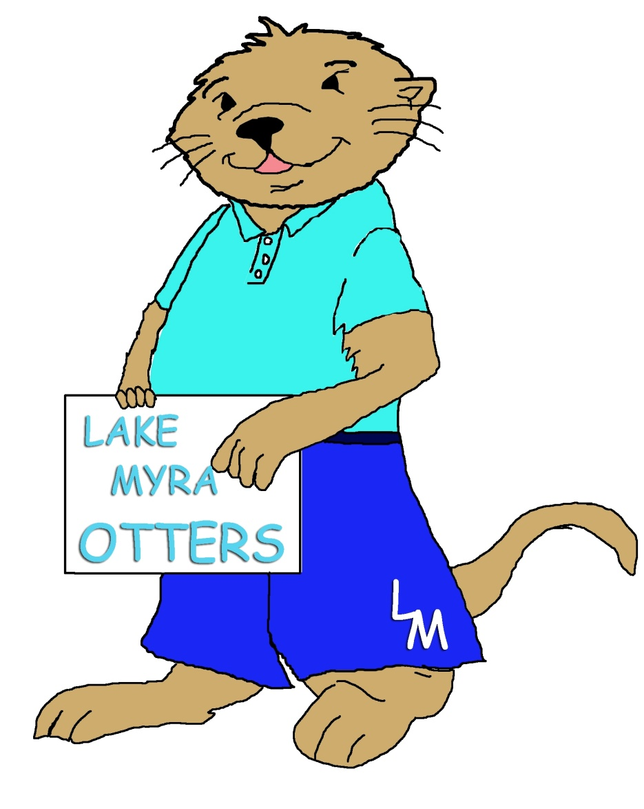
Lake Myra Elementary School

Slide 2
Introductions

Slide 3
Mission and Vision
Our Mission is to provide a learning environment that is engaging, caring, nurturing, and safe for all learners.
Our Vision is Preparing all learners for their future.

Slide 4
Our Values:
A safe, loving, and nurturing learning environment
Allowing students to problem solve safely, make mistakes, and think creatively outside the box.
High expectations for everyone
Giving children validation and a feeling of self-worth
Data driven decisions based on growth
Collaboration
Providing opportunities and challenges for all
Caring about each other and the world
Looking at children as individuals
Learning as an active process, not a passive one
Motivating a love for learning
Modeling how to be good citizens
A student’s right to our very best every day

Slide 5
Commitment to Learning

Slide 6
The Five C’s
Collaboration
Communication
Creativity
Critical Thinking
Caring

Slide 7
The Core Curriculum
Emphasis on GROWTH for all students
Rigor
Engagement
Differentiation
Remediation
Enrichment

Slide 8
English/Language Arts
Guided Reading
Reader’s Workshop
Writer’s Workshop
Leveled Text

Slide 9
Math
Math Workshop
Math Talk
Pre- and Post-Assessment
Problem Solving
Vocabulary Development

Slide 10
Science
Hands-On Kit Based Instruction
Vocabulary Development
Science Notebooking
Integration into Literacy with texts

Slide 11
Social Studies
Non-fiction Texts
Technology integration
Integrated into literacy blocks

Slide 12
Specials
Art
Music
Physical Education
Guidance
21st Century Learning

Slide 13
PBIS
Explicitly Teaching Expectations
Rewarding Successes
Developmentally Appropriate Consequences
PBIS Heart

Slide 14
Enrichment and Remediation
ENRICHMENT
PLTs
Real-Time
AG Program
Explorers Program
K.I.T.S. – K-2
Instructional Practices
REMEDIATION
PLTS
Real-Time
R.O.M.P. Talk
Otter Talk
Response to Intervention

Slide 15
Lake Myra Traditions
Fun Run
Super Kids Day
McTeacher Night
Read Across America Week
Grade Level Performances
Book Fairs
Strong PTA
Take Home Reading
Principal Summits
Title 1 Family Nights

Slide 16
Extras
Before and After School Care
R.O.M.P. Chorus
Art Club
Runners Club
First In Fitness
Recorder Ninjas
Music Matters
Student Council
Cultural Arts

